Slide 1

Lead &
Opportunity
Scoring

Slide 2




Meet the team
Bing Lesley Yuan , Xin Li , Xinhui Lu , Ziyan Zhao , Raelene Huang
350274,1029029,965246, 1020405, 694488
Limited Resources!

Slide 3
Client
University of Melbourne’s constituents' team
Research Collaborations
Focuses on industry partners
Offers research collaboration, consultancy and innovation collaboration.
Scope of the Project
Develop a scoring model for the opportunities
Gain insights / determine the key drivers
Limited Resources!

Slide 4


Problem Statements
01
Generate a lead scoring model
Scoring each lead/opportunity in terms of its likelihood of success of conversion into a financial agreement and relationships.
02
What are the key drivers for successful conversion?

Slide 5
Key Challenges
ML challenges:
Dealing with missing data (data cleaning)
Feature transformation (categorical data)
Feature selection
Imbalanced dataset
Model tuning
Model selection
Validating performance
Interpreting models and results
Things we cannot control:
Lots of missing data, and missing data entries
Integrity of the data

Slide 6
Machine Learning Pipeline
Model Monitoring
Pre-Processing
Model Validation
Data Integration
Model Training
Model Deployment

Slide 7
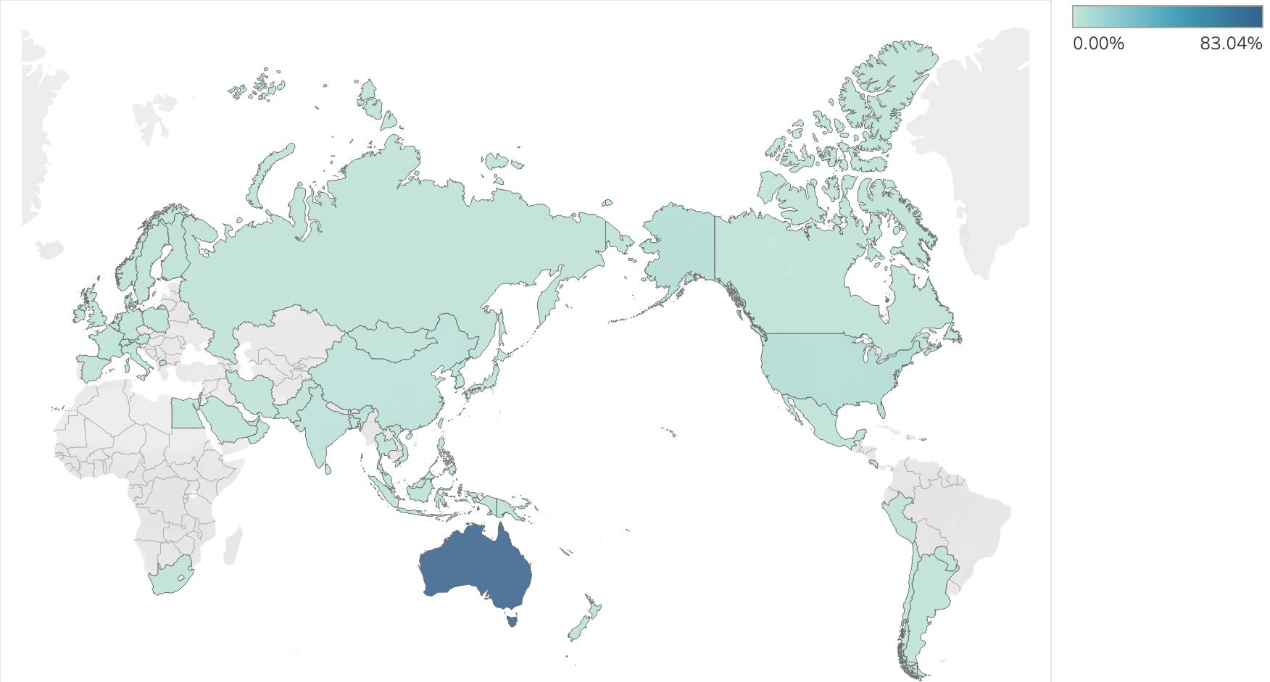
Research Data
7598 historical leads
5408
38 features
19
Converted Rate: 37%
External Opportunities: 99.2%
Australia, US, Europe and Asia

Slide 8
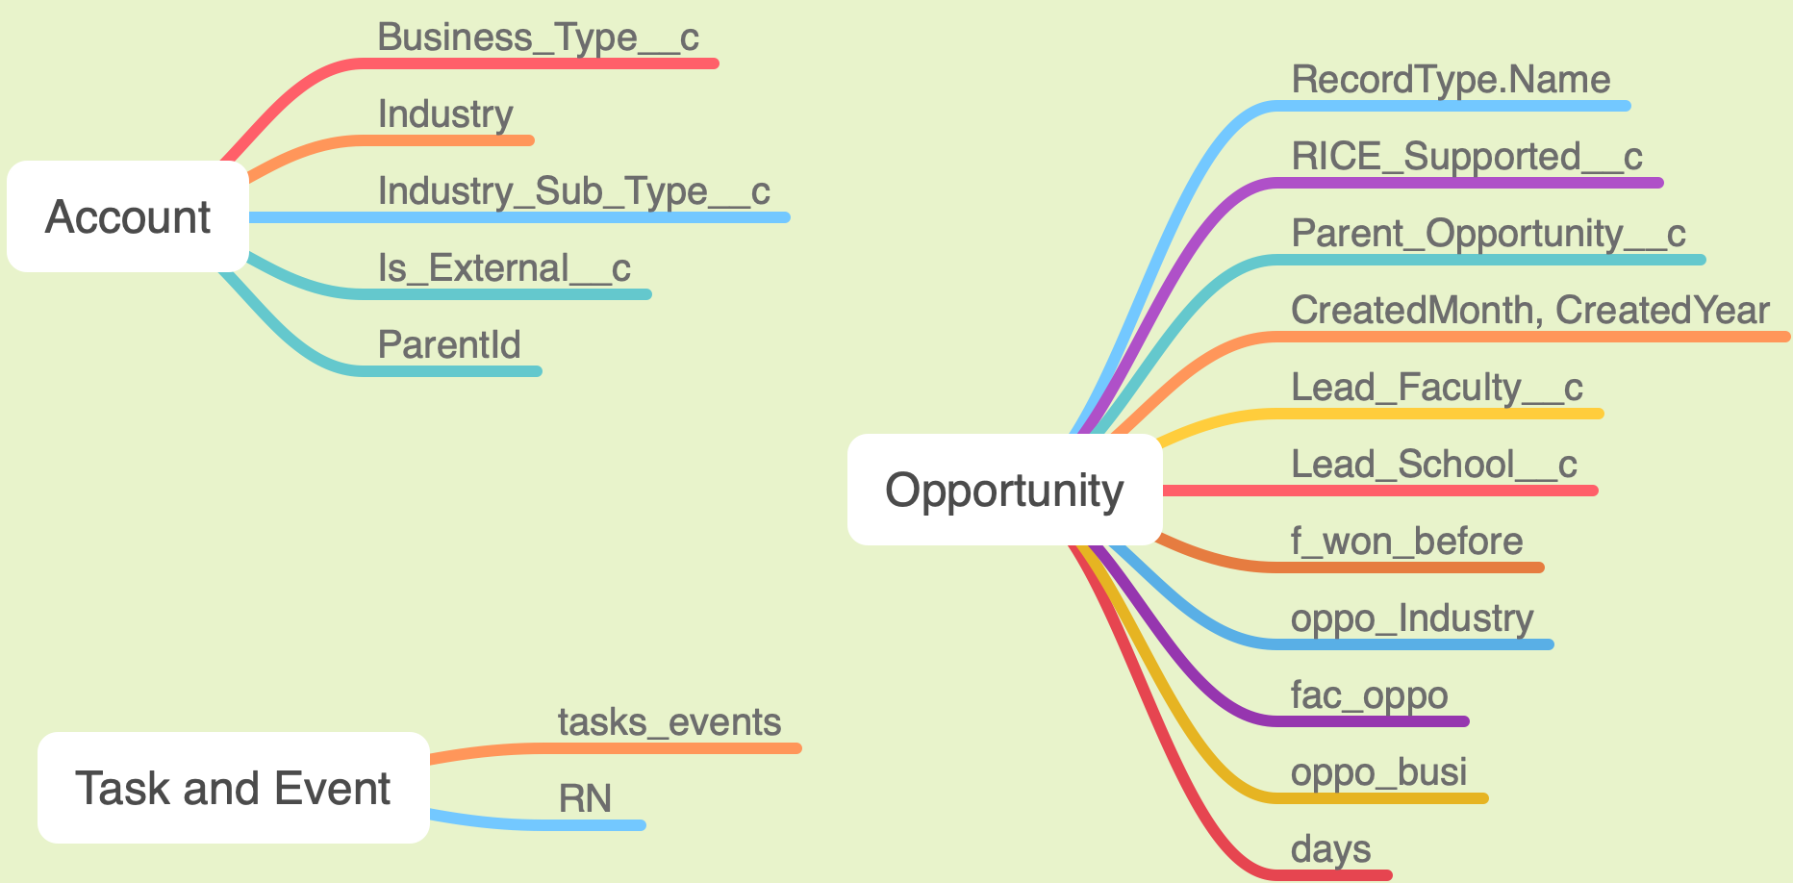


Slide 9
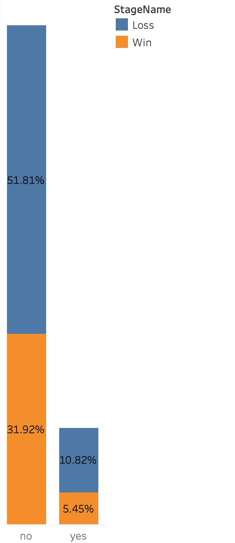
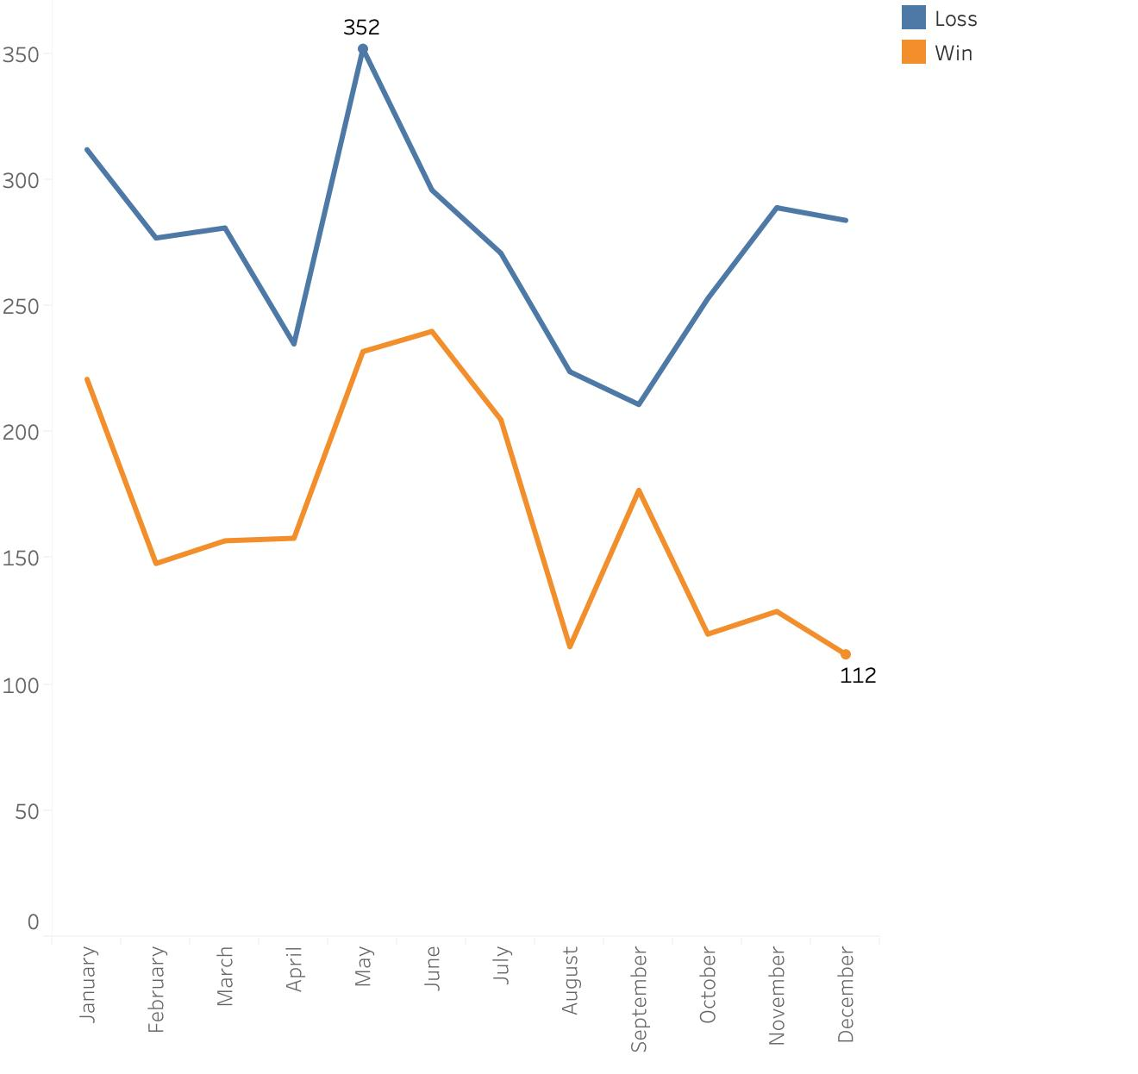
38% converted
33% converted
New Old
Clients

Slide 10
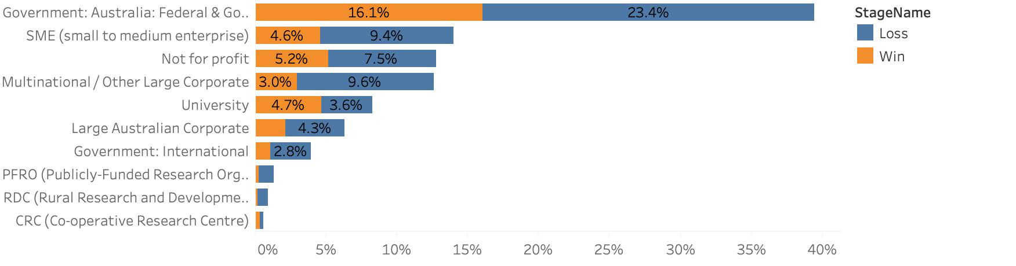

Business Types:
AVG:35%
41% converted
33% converted
57% converted
50% converted

Slide 11
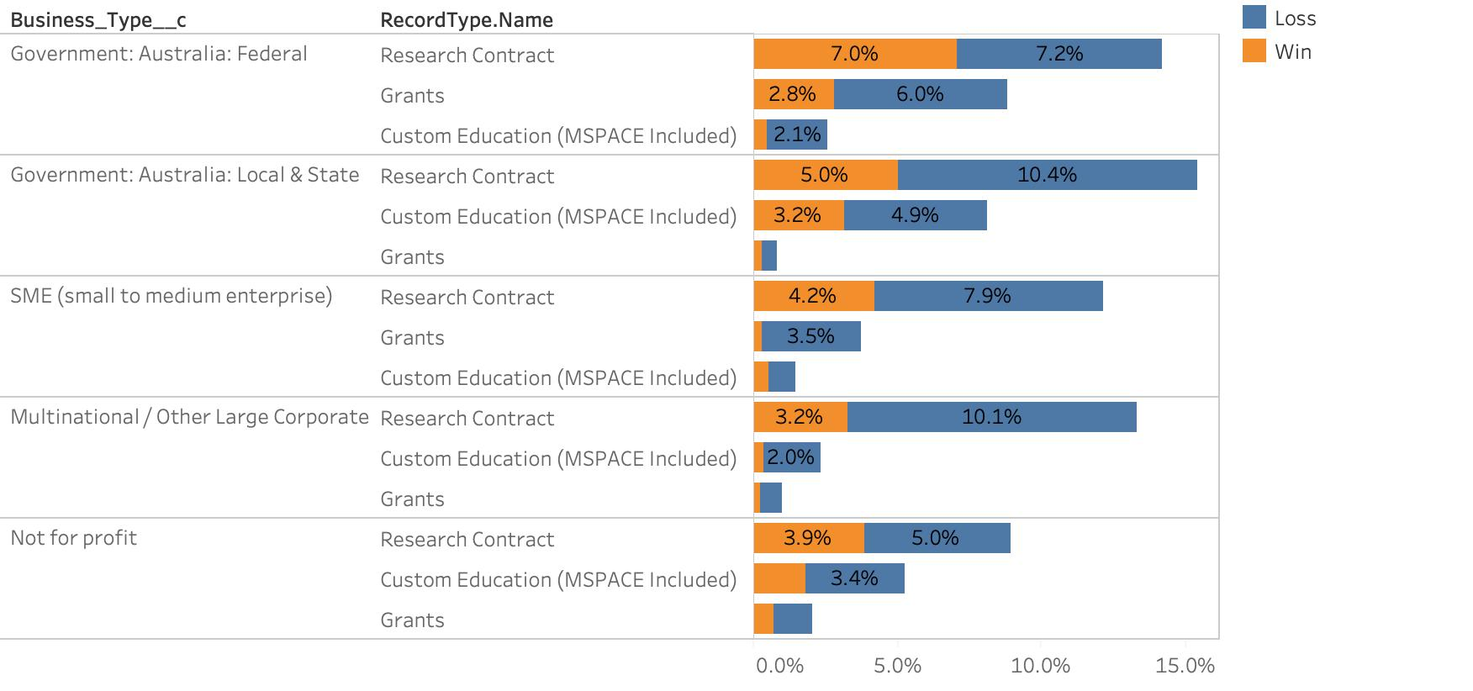

Slide 12
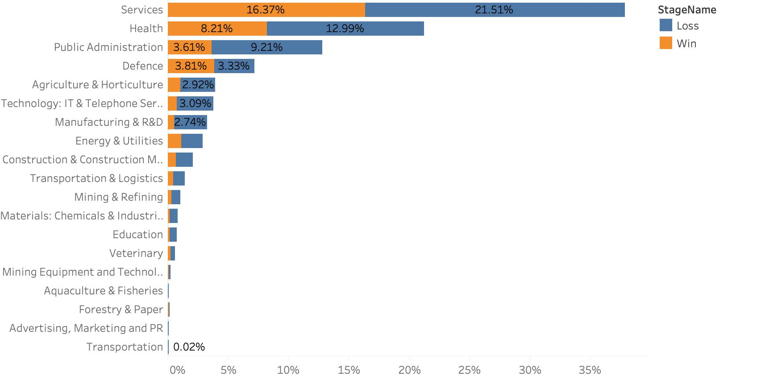
Industry:
AVG: 29%
43% converted
53% converted
18% converted

Slide 13
Added Features
Our own features:
RN
the number of opportunities have been made with the same accountID
F_won_before
If the related client of the current opportunity has a previous opportunity won before.
Days
Days between close and create
Cross features:
Oppo_industry
Fac_oppo
Oppo_busi

Slide 14
Balancing Data

Slide 15
Classification Models
Successful
(Positive)
Population of Opportunities
Binary Classification Model
Unsuccessful
(Negative)
Logistic Regression
Support Vector Machines
Random Forest
Deep Neural Network

Slide 16
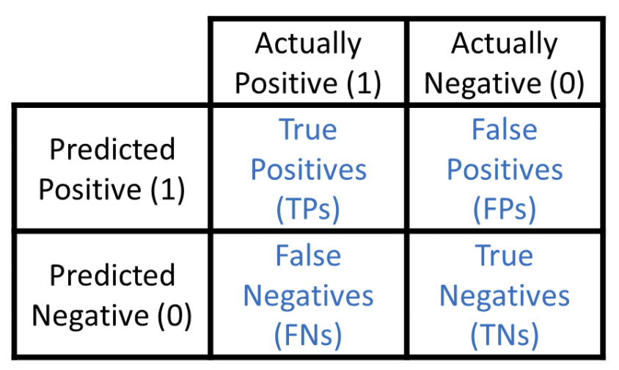
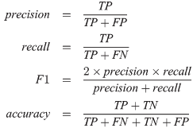
Evaluation Metrics
Accuracy
Precision
Recall
F1 measures

Slide 17
Logistic Regression
01
Why LR first?
High interpretability
Can efficiently describe the relationship between a dependent binary class and the parameters
Examine the Significance of the Features
Give a baseline metric for our latter models
02
Evaluation method
Base (14 variables), additional (3 variables) and cross-features (3 variables)
Dataset 1: Base
Dataset 2: Base + additional
Dataset 3: Base + cross-features
Dataset 4: Base + additional + cross-features
03
Feature importance
19 variables and around 300 features
Only whose p-value < 0.05 are considered as significant features
Notes:
Script
Hi, I’m Ziyan. And I will start presenting the binary classification model section. We chose Logistic regression as our first model to give a baseline metric for our latter models, since LR has high interpretability, it can efficiently describe the relationship between a dependent binary class and the parameters and can examine the significance of the features.
Our models run on 4 different combinations of variables from the same dataset to seek the optimum.
Dataset 1 includes the 14 variables in the “Base” section, dataset 2 includes both the “Base” variables and 3 “Additional” variables, dataset 3 contains both the “Base” variables and 3 cross-feature variables, and dataset 4 contains all the variables.
We use R for LR modelling. As we can see from the graph, the result we have cannot prove our assumption that “the amount of feature has a positive impact on the performance of model “. dataset 2 has the highest score in all categories, however, the performance of other dataset is not optimal. Even though dataset 4 has the most features, it only performs slightly better than dataset 1 which has the least feature. On the other hand, dataset 2 and dataset 3 have the same amount of features, but the difference between the results is significant. base on the results, We have noticed that datasets with cross-features tend to have worse performance.
There are 19 variables and around 300 features. The number of features is more than the number of variables because the categorical variables are represented by features as we are using one hot encoding.
We don’t include every feature into the final logistic model. We choose features by their p-value, only whose p-value less than 0.05 are considered as significant. More specific, the the p-value, the more important the feature.
Next, …
------------------------

Slide 18


Model selection
Research Data Set
5048 rows
15 features
Small data set
High bias & Low variance
SVM
Naive Byes
Limited Resources!

Slide 19

SVM & Oversampling
 | Imbalanced data set | Balanced data set
Accuracy | 0.6207 | 0.5975
Limited Resources!

Slide 20
Different Data Sets

Slide 21

Random Forest
No assumption for data
Without a large amount of tuning work
Features importance
Analysis

Slide 22
Random Forest
&
Oversampling
 | Imbalanced data set | Balanced data set
Accuracy | 0.61415 | 0.849015

Slide 23
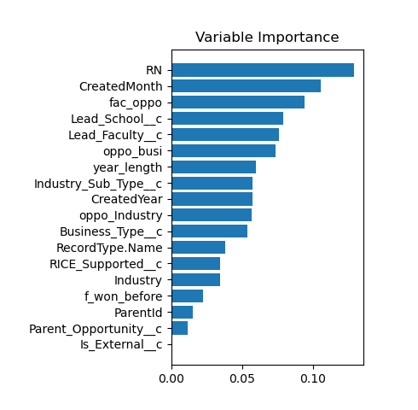

Different Data Sets
X EDUCATION

Slide 24
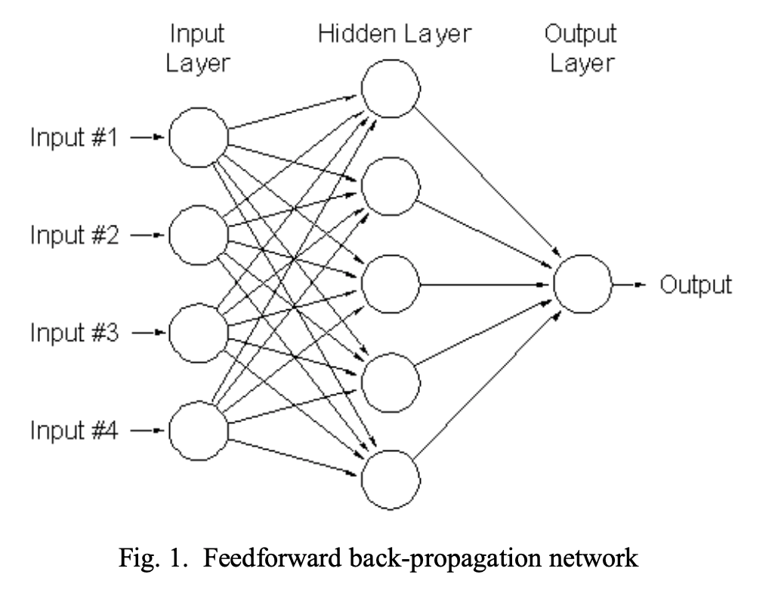
Deep Neural Network
5 hidden layers
256 nodes per layer
ReLu activation function between hidden layers
Sigmoid output function
Features:
Base (14 variables)
Additional (3 variables)
Cross-features (3 variables)

Slide 25
Deep Neural Network Results
Handover to Bing

Slide 26
Comparing all models
Column1 | Logistic | SVM | Random Forest | DNN
Accuracy | 0.7345 | 0.6207 | 0.84902 | 0.84399
Precision | 0.6364 | 0.48561 | 0.81627 | 0.79324
Recall | 0.6467 | 1 | 0.88449 | 0.96808
F1_score | 0.6415 | 0.65375 | 0.84902 | 0.87143
Handover to Bing

Slide 27
How to interpret models
LIME
Local interpretable model-agnostic explanations
LIME also makes more human friendly explanations that explanations are selective and possibly contrastive
LIME does work better with models that output probabilities for classification problems
Why?
The better performing models are often called blackbox models such as random forests, XGboost trees or neutral networks and these models are generally more complex and don’t have a simple way for interpreting their predictions or outcome.
SHAP
Given the current set of feature values, the contribution of a feature value to the difference between the actual prediction and the mean prediction is the estimated Shapley value.
It is also possible to misinterpret shapley value.

Slide 28
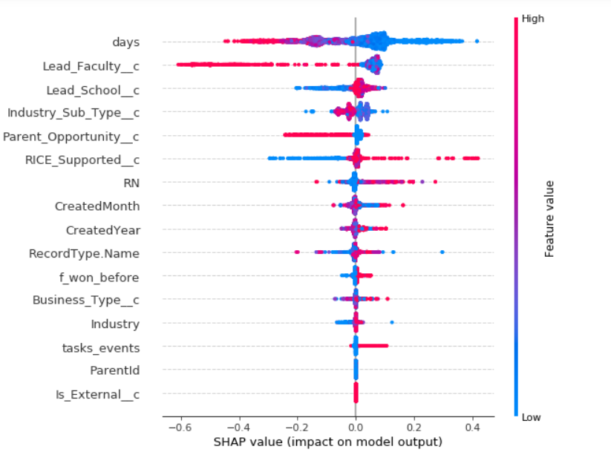
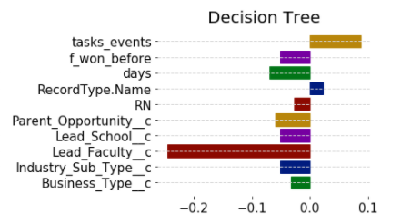
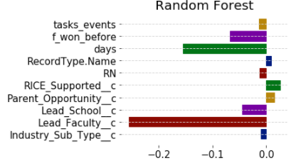
Results

Slide 29
THANK YOU!

Slide 30
Thank you
Any feedback?
Is handover required?

